Slide 1
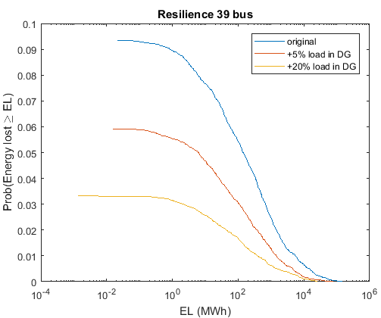


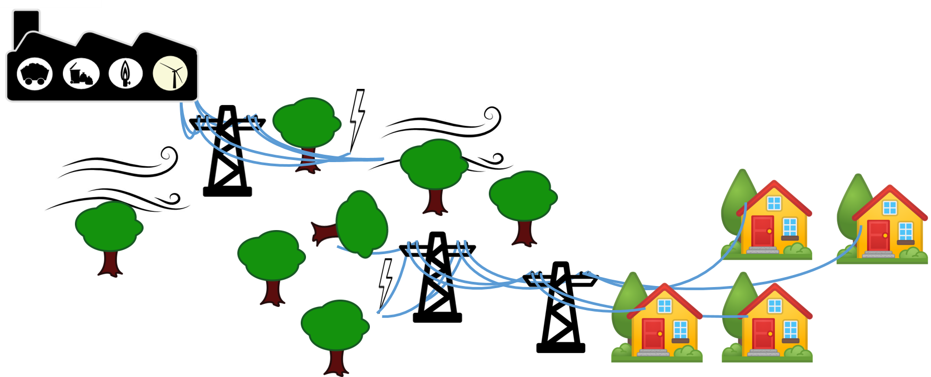
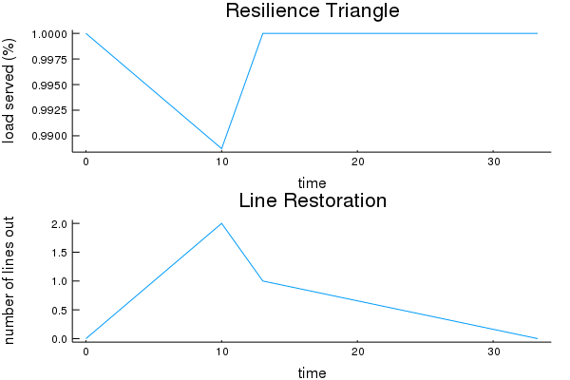
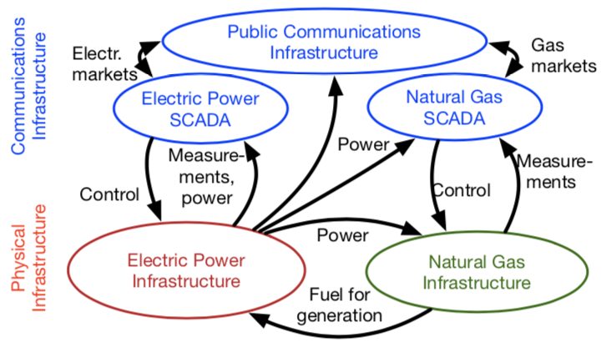
Measuring Power System Resilience Based on Empirical Data
Molly Rose Kelly-Gorham, Paul Hines, Ian Dobson (Iowa State University)
Abstract
Measuring Resilience of Power Systems
Preliminary Results
Increase in number and severity of large storms from climate change show a need to understand resilience of critical infrastructure
First step is to quantify resilience of a power system
Developed an integrated approach to quantify resilience in transmission networks
Model uses empirical data from large US utility to develop probability distributions of
Number of line failures that occur within an event
Recovery times for lines that fail
Demonstrated by measuring impact of potential improvements to a power system
Event
Integrating unserved demand over time (lost energy) provides a measure of the resilience for a power system to a single event.
A distribution of many potential events leads to a distribution of energy losses and is a measure of the resilience of the power system.
Resilience Distributions
Restore
Initial Outages
Cascade
Resilience
Robustness
Rapid Restoration
Redundancy
Resourcefulness
Empirically Based Model
Measure
Update
Fraction of Load Served
Use distributions of number of line outage and recovery time data from a large US utility [3,4] to initiate outages and find restoration times.
Find initial lost load with Load Shedding Optimal Power Flow
As lines are restored, find lost load with the Restoring Load Optimal Power Flow
Measure resilience
Repeat 1-4
Future Work
Coupling power system, natural gas and communication system models
Background
Most existing literature focuses on individual stage of the resilience; i.e component reliability, cascading failures, or restoration
A few early comprehensive efforts have produced frameworks and metrics to measure resilience [1]
Preliminary work has estimated system resilience to certain hazards; combining a good measure of component outages given a level of stress and probabilities of that stress occurring into a resilience framework [2].
Number of Lines Down
time
References
M. Bruneau, S. E. Chang, R. T. Eguchi, G. C. Lee, T. D. ORourke, A. M. Reinhorn, M. Shinozuka, K. Tierney, W. A. Wallace, and D. von Winterfeldt, “A framework to quantitatively assess and enhance the seismic resilience of communities,” Earthquake Spectra , vol. 19, no. 4, pp. 733–752, 2003.
M. Panteli, C. Pickering, S. Wilkinson, R. Dawson, and P. Mancarella, “Power system resilience to extreme weather: Fragility modeling, probabilistic assessment, and adaption measures”, IEEE Transactions on Power Systems, vol. 32, no. 5, pp. 3747–3757, 2017.
S. Kancherla and I. Dobson, “Heavy-tailed transmission line restoration times observed in utility data,” IEEE Transactions on Power Systems, vol. 33, no. 1, pp. 1145–1147, 2018.
“BPA transmission services operations reliability,” Apr. 2017. [Online]. Available: https://transmission.bpa.gov/Business/Operations/Outages

